Slide 1
Chapter 14 Linear Algebra and Systems of Linear Equations
By
Hyung Jae (Chris) Chang
Troy University

Slide 2


Basic of Linear Algebra
Sets
Mathematics view of the set data structure: a collection of objects
Denoted by a pair of braces: { }
Example: S = {orange, apple, banana} meaning that the set S contains orange, apple and banana.
Union: $A∪B$
Intersection: $A∩B$
Empty set$:∅$
Contain: $a∈A$
Set minus: $A\backslash a$ → A minus the element $a$

Slide 3
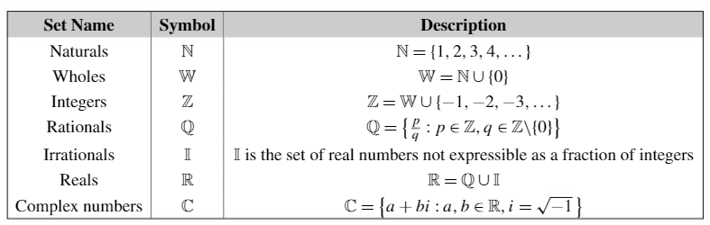
Standard Set related to Numbers

Slide 4




Vectors
Set $R^{n}=\{\left(x_{1},x_{2},…x_{n}\right):x_{1},x_{2},…x_{n}∈R\}$ → set of all n-tuples of real number → $R^{3}$ represents the set of real triples (x, y, z) coordinates in 3D space.
Row vector: vectors written horizontally
Column vector: vectors written vertically
Zero vector: vector in $R^{n}$ containing all 0s
Norm: a measure of the vector’s length
L1 norm (Manhattan distance):
L2 norm (Euclidean distance):
p-norm (L_{p}):
$L_{∞}$norm: p-norm where p = $∞$ (maximum absolute value in v).
$${\left\|v\right\|}_{1}=\sum_{i}{|v_{i}|}$$
$${\left\|v\right\|}_{2}=\sqrt{\sum_{i}{v_{i}^{2}}}$$
$${\left\|v\right\|}_{p}=\sqrt{\sum_{i}{v_{i}^{p}}}$$

Slide 5
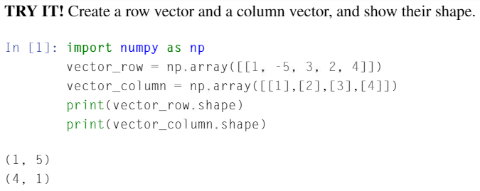
Vectors (cont.)
Vector example 1 in Python

Slide 6
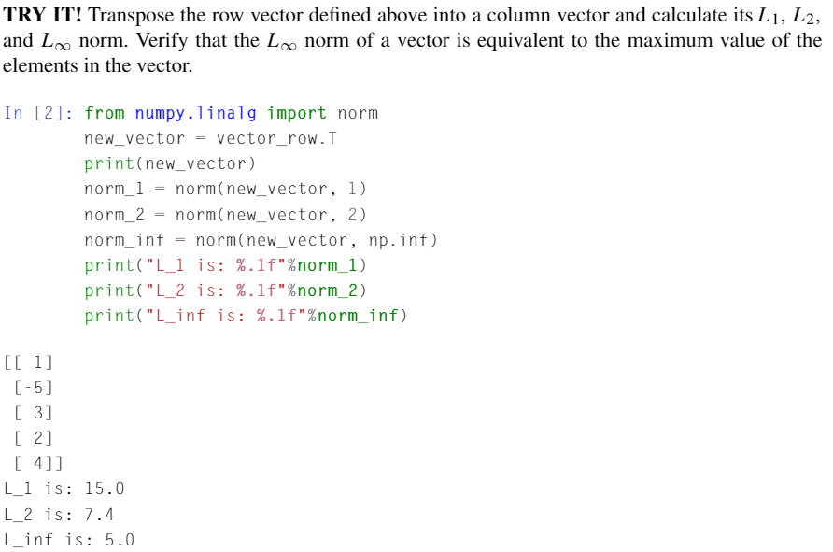
Vectors (cont.)
Vector example 2 in Python
norm
p-norm
inf-norm là lấy trị tuyệt đối các element nên ở đây max là 5

Slide 7
Vectors (cont.)
Vector addition: pairwise addition of the elements of the added vectors.
Vector multiplication
Scalar multiplication: the product of a vector and a scalar → the product of each element of the vector by the scalar. (u=αv (u_{i} = αv_{i}) where α is a scalar and v is a vector)
Dot-product of two vectors: the sum of the products of the respective elements and is denoted by “∙” (i.e. v∙w where v and w are vectors.)
Angle between two vectors, θ, is defined by the formula,
.
Cross-product between two vectors (v and w: v×w) is defined by the formula where θ is the angle between the v and w and n is a vector perpendicular to both v and w.

Slide 8
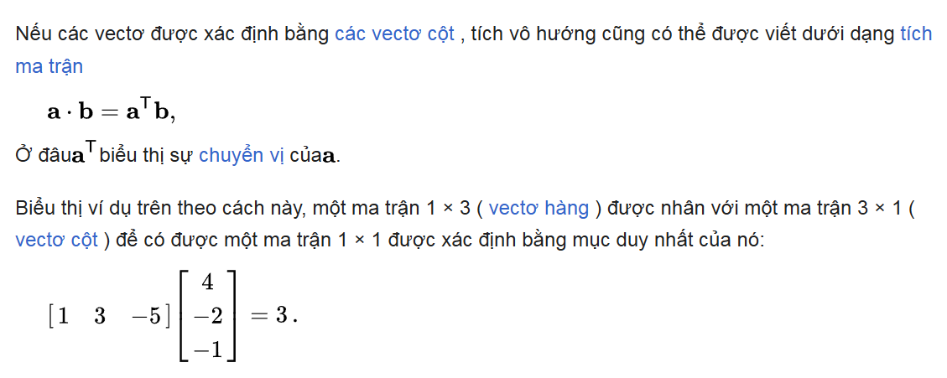
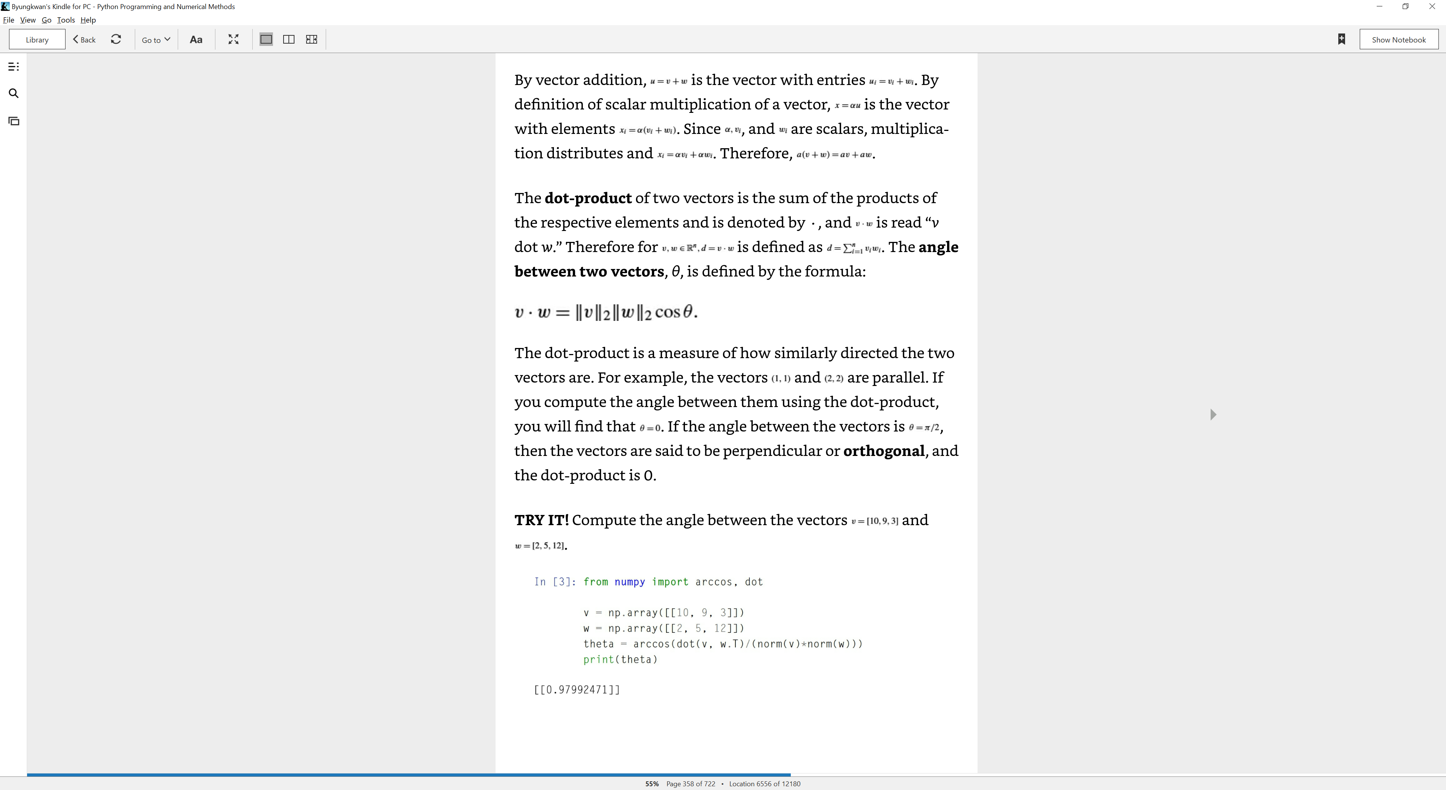
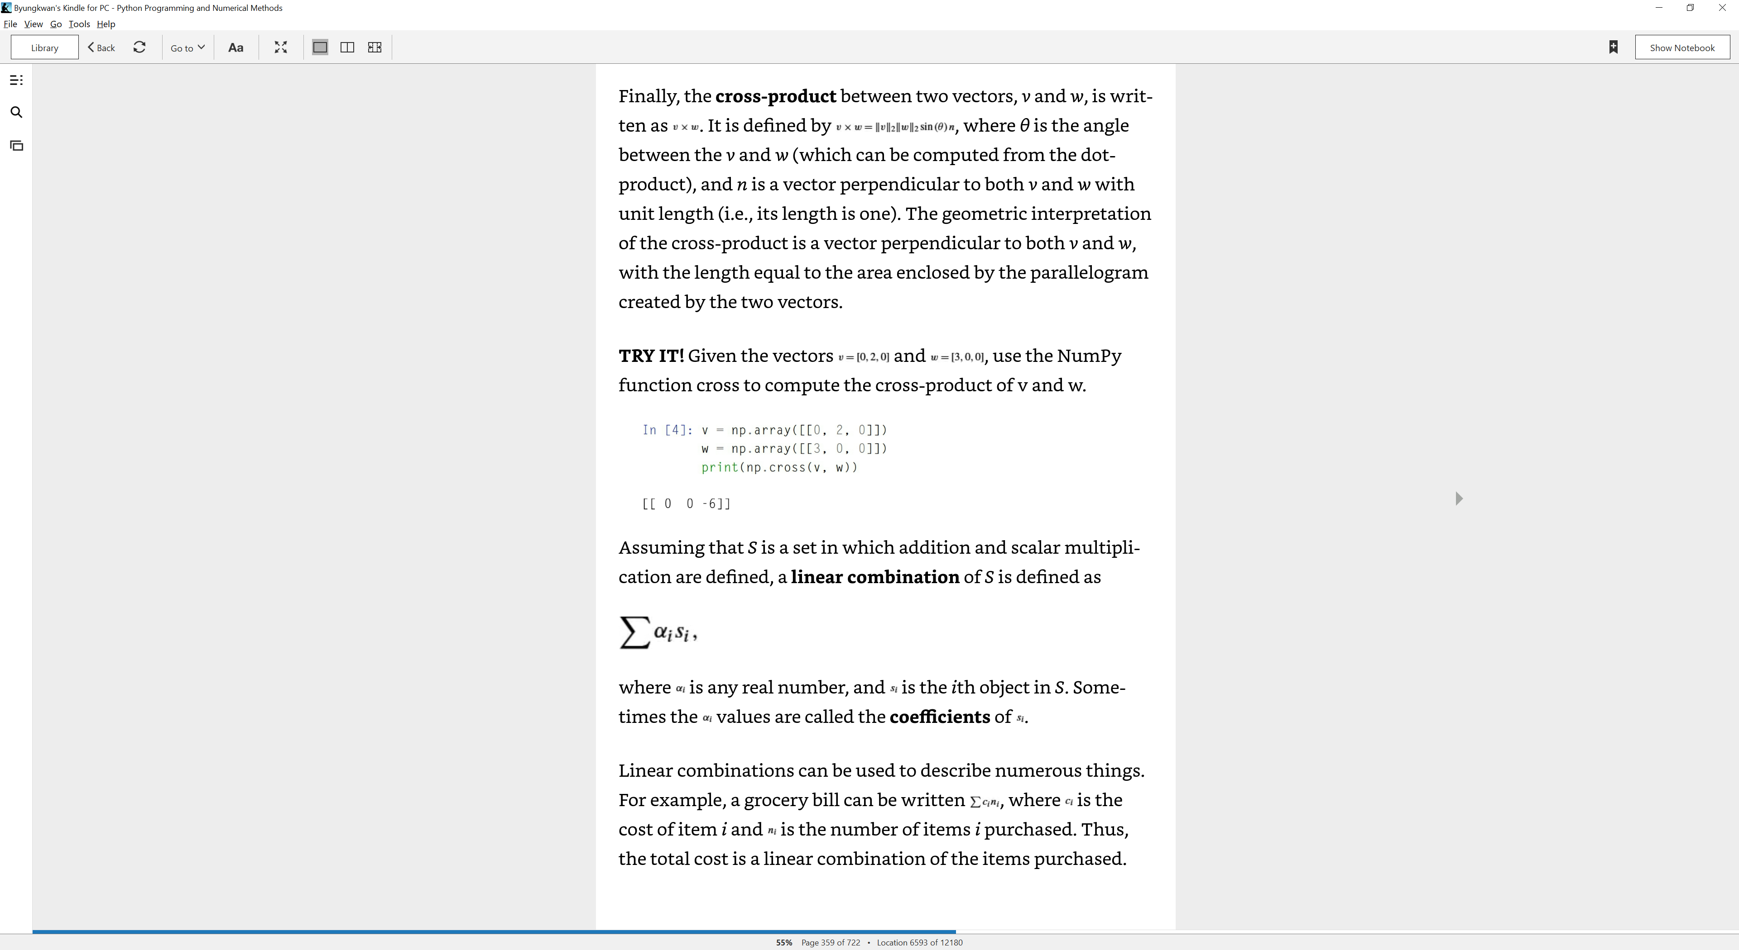
Vectors (cont.)
Python code
Angle
Cross-product

Slide 9
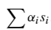
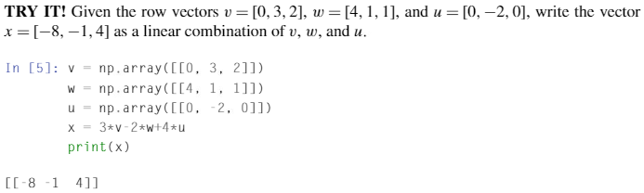
Vectors (cont.)
Linear combination: where α_{i} is any real number and s_{i} is the ith object in set S. Sometimes, α_{i} is called the coefficients of s_{i}.
Linear combination example
A grocery bill can be written as where c_{i} is the cost of item i and n_{i} is the number items i purchased.

Slide 10
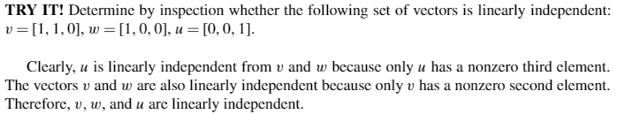
Vectors (cont.)
A set is called linearly independent if no object in the set can be written as a linear combination of the other objects in the set. A set of vectors which is not linearly independent is linearly dependent.

Slide 11
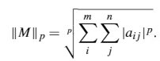
Matrices
m x n matrix: a rectangular table of numbers consisting of m rows and n columns.
p-norm
where m x n elements of M are treated as the elements of an mn-dimensional vector
m x n matrix addition: same as vectors

Slide 12
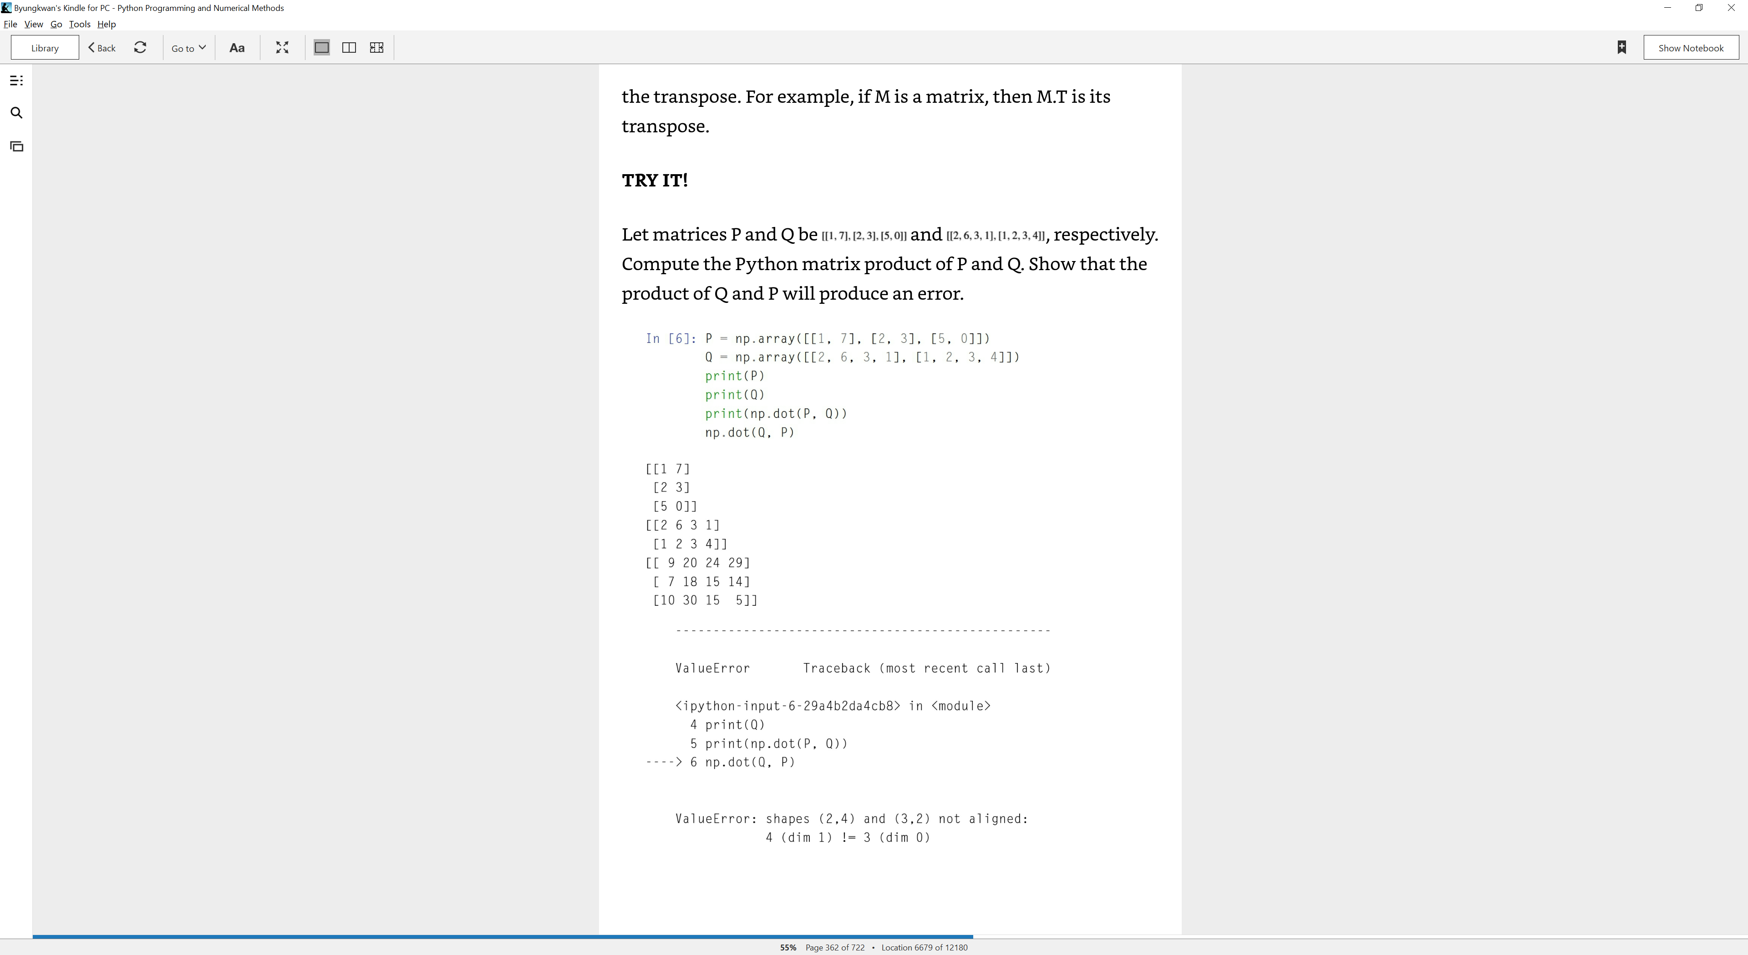

Matrices (cont.)
m x n matrix multiplication of two matrices P and Q where P is a m x u matrix and Q is a u x n matrix. Then the result of M = PQ is a matrix M that is m x n.:
$$M=PQ=M_{ij}=\sum_{k=1}^{u}{P_{ik}Q_{kj}}$$

Slide 13
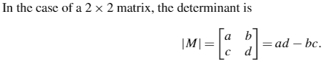
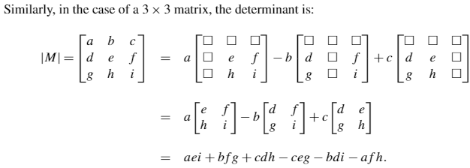
Square Matrix
Square matrix: n x n matrix
Determinant: a special number that can be calculated directly from a square matrix. (for inverse calculation or the solution for systems of linear equations)
To use determinant in Python
“from numpy.linalg import det”

Slide 14
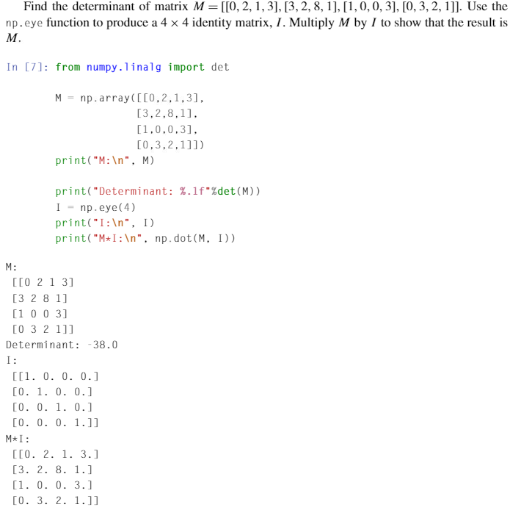
Identity Matrix
Identity matrix: a square matrix with 1s on the diagonal and 0s elsewhere.
Identity matrix is usually denoted by I and is analogous to the real number identity, 1.
Multiplying any matrix by I will produce the same matrix.

Slide 15
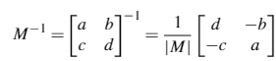
Inverse Matrix
Inverse of a square matrix M: a matrix of the same size, N, such that M∙N = I.
The inverse of a matrix is analogous to the inverse of a real number (3 x 1/3 = 1)
A matrix is said to be invertible if it has an inverse.
There exists only one inverse matrix.
Square matrix M → its inverse M⁻¹
Can be computed using a function “inv” from NumPy’s linalg package in Python
Example (2 x 2 matrix)

Slide 16
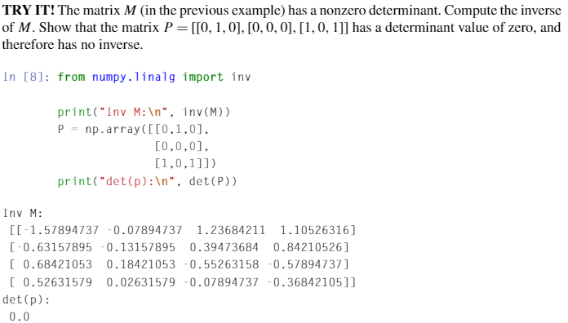
Inverse Matrix (cont.)
Real numbers: 0 has no inverse for multiplication
Singular: matrices that do not have inverses
Nonsingular: matrices that do have an inverse
If the determinant is 0, then the matrix is singular, if no, the matrix is non-singular.
In Python:
Det = 0 => suy biến, else : ko suy biến

Slide 17
ill-Conditioned Matrix
A matrix that is close to being singular (i.e., the determinant is close to zero) is called ill-conditioned ( gần suy biến ).
Such matrices are problematic numerically (like dividing a number by a very, very small number)
May cause overflow, underflow or numbers small enough to result in significant round-off errors.
The condition number is a measure of how ill-conditioned a matrix is → it is defined as the norm of the matrix times the norm of the inverse of the matrix, that is, .
We can use NumPy’s function “cond” from “linalg”.

Slide 18
Rank of a Matrix
The rank of an m x n matrix A
The number of linearly independent columns or rows of A and is denoted by rank(A).
The number of linearly independent rows = The number of linearly independent columns
A matrix has full rank if rank(A) = min(m, n) or if all of its columns are linearly independent.
An augmented matrix: a matrix A concatenated with vector y and is written [A, y] (A augmented with y).
rank([A, y]) = rank(A) + 1 → the vector y is “new” information.
Rank → important because it is related to the solutions of linear equations.

Slide 19
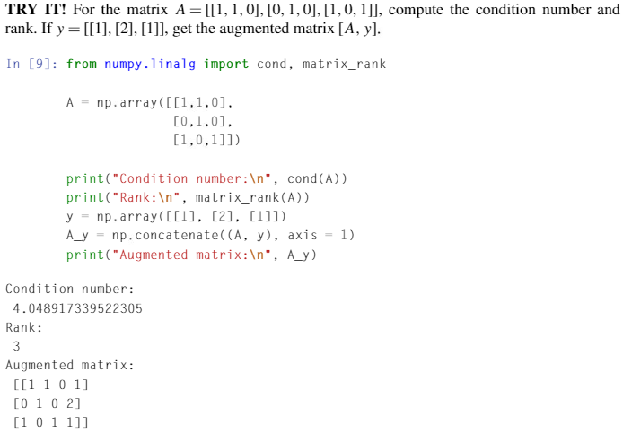
Rank of a Matrix (cont.)

